Slide 1
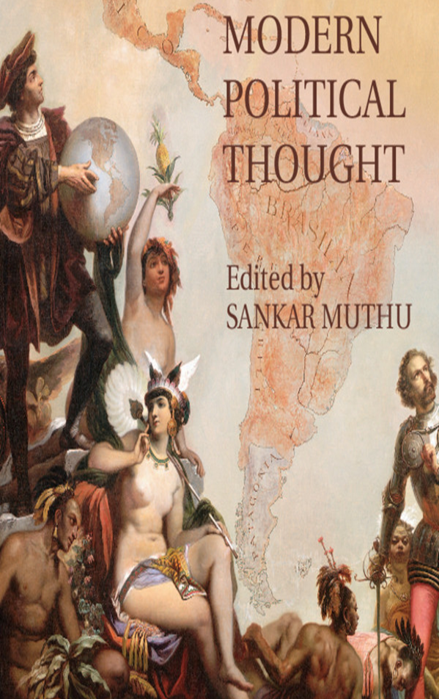
Chapter 26: Social Attitudes, Liberal Reform, and Conservative Reaction
Irena Yang
Period 5
1/30/12

Slide 2

The Old “Empire”
Late 18th and 19th century forces contributed to decline:
Europeans amassed New World empires beginning in the 16th century with the Spanish Conquistadors
European states engaged in trade monopolies with their colonies
Mercantilism ruled the New World colonies
Internal:
Rise of market economy
Cultural revolution propelled by Enlightenment
External:
Independence movements
Slave revolts
African Slave labor formed the backbone to the plantation economy that supported these empires
Religion formed a moral justification for these empires and missionaries saved the souls of “heathens”
Diminished old empire’s foundations

Slide 3

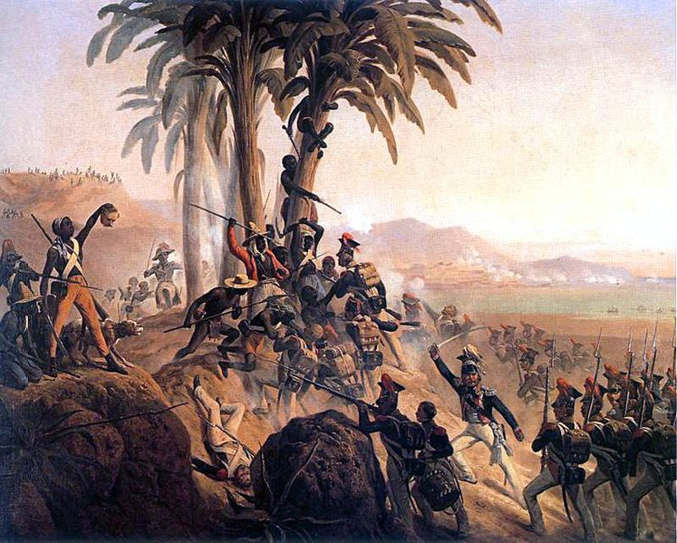
External Forces
Haitian Revolution:
Battle on Santo Domingo (Polish troops employed by French vs. Haitian rebels)
Click picture for more info
Independence Movements:
Start: American Revolution
1804-1824: Many European powers lost New World colonies
  France lost Haiti, Portugal lost Brazil, Spain lost most of Latin America (kept Puerto Rico and Cuba)
Latin America:
  Creoles (American born of European descent) led movement for independence from Spain
Slave Revolts:
Slave revolts erupted in second half of 18th century
  from Dutch Surinam
  to British Jamaica
Maroon Wars: sporadic guerilla warfare against local plantations in the late 18th and early 19th centuries
  Haitian Revolution: French colonies culmination in Saint-Domingue in 1791

Slide 4

Internal Forces
Antislavery Movement in Europe:
Organized in: France and the Netherlands
Strongest campaign where? Britain
Religious Sentiment accelerated influence
  Newer forms of Protestantism in the 18th century condemned slavery as a sin (Quakerism)
Abolitionism spread to the Religious mainstream
Enlightenment Influences:
Philosophers previously defined slavery as a rational and efficient social and economic system
HUMANIST INTELLECTUAL CULTURE
  John Locke condoned slavery in his 17th century arguments
    critiqued arbitrary power,
    appealed to rule by reason, and
    championed natural and universal human rights
Click for “Locke & Slavery”

Slide 5

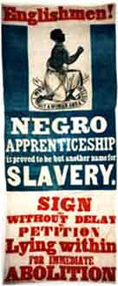
Causes of Abolition of Slavery
Religious fervor
Economic rationale
Enlightenment Universalism
1834: Britain 1st European country to abolish slavery
  emancipated 780,000 slaves in the West Indies
  government paid 20 million euro slave owners to compensate for the lost property
  Information on anti-slavery campaign in Britain click here
Antislavery fashionable among the European (wealthy women)
Enlightenment economists critiqued the slave-based economy and mercantilism as a whole
basic sameness of all humans
emphasis on the inner good undermined the European need to civilize enslaved peoples
Romantic poets attacked slavery and tyranny (ex. Percy Shelley)
MARKET COMPETITION: both rational and natural
Religious emphasis on goodness of humans
  Slave: innocent victim
  European: heroic savior
Slavery clashed with Enlightenment ideas (3):
individual’s natural right to freedom,
equality before the law, and
ownership of one’s self and one’s labor
Adam Smith rebuked the inherent inefficiency of slave labor
lacked incentive to work hard and could not be laid off
  wealthy joined abolitionist groups, circulated images that exposed the cruelty of slavery
    18th century real world ex. HAITI and JAMAICA

Slide 6

End of Slavery Timeline
Slave trade essentially ended
Spanish Cuba
United States
1848 1850 1863 1865 1873 1886 1888
Dutch New World
Puerto Rico
France & Denmark
Brazil
Click on a box to learn more

Slide 7

Rise of New Liberal Empire
Growth in:
Industrial capitalism
Market economy
New economic rationale of free trade and economic liberalism
New philosophical foundations
Influence of Enlightenment
Enlightenment Universalism
More skeptical of supposed cultural superiority
Increase in colonial conquests
Cultural Relativism

Slide 8

Economic Liberalism
Merchants and industrialists wanted to replace mercantile colonialism with free trade
Free-trade advocates became richer and more influential
Self-regulating market advocated early on by Adam Smith and David Ricardo became common sense
However, economic practices occasionally contradicted with this imperial idea
  1830-1870, European powers competed for spheres of economic influence
    This era constituted the peak era for economic liberalism
  BUT…
  Europeans quickly abandoned free-trade when indigenous peoples and other Europeans threatened their own economic interests

Slide 9

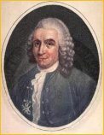
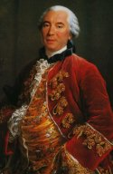
Enlightenment Universalism
Click either picture for Pre-Darwinian theories of evolution including those of Carolus Linnaeus and Comte de Buffon
Carolus Linnaeus (1707-1778) Comte de Buffon (1707-1788)
Liberal empire applied reason to social reform which affected human improvement
Ideas included the human biological and cultural sameness
  Pre-Enlightenment stressed the permanent gap between Europeans and Africans or indigenous cultures
  18th century philosophers preached the similarities among human societies
Enlightenment scientists assumed that the races of man belonged to a single species
Created the idea of a common developmental path for all societies
  While some societies achieved a higher level of civilization than others, all societies occupied a position on this path
  This belief encouraged the idea that societal change could be accelerated and guided through social intervention

Slide 10

Cultural Relativism
  During Enlightenment “the abundance of still-fresh accounts of travelers charting unknown territories and peoples led to the construction of idealized versions of their exotic cultures and a valorization of their beliefs and outlooks…These authors were also the first to explore the idea of viewing one’s culture from an outsider’s point of view and using this external perspective as a vehicle to criticize local customs and norms” (Baghramian)
  Ex. Voltaire, Diderot, Montesquieu showed strong interest in distant cultures
Recognized the value of other societies
  French Philosophe VOLTAIRE admired ancient Chinese and Islamic civilizations
  English historian EDWARD GIBBON respected Islam
  Evangelical missionaries
    preached Christian brotherhood
  Jean-Jacques Rousseau
    New World societies as models of virtue and freedom (cult of the noble savage)
Many European cultural relativists:
  retained the idea of their own supremacy
  recognized the accomplishments of other societies

Slide 11
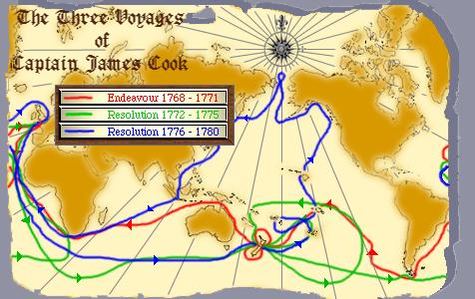
Captain Cook
Goal: locate the missing continent known as Terra Australis
Illustrate the ideology of the new liberal empire
Cook’s motives: 1) commercial 2) scientific
European exploration and expansion
Justification for expansionism (2):
  advancing science, further spreading civilization
Natives gained inherent rights through universalist doctrine
Cultural relativism made European explorers see the value in other societies
The Royal Scientific Society
  partially sponsored Cook’s South Seas voyage
  cautioned Cook to treat local cultures with respect and dignity
Click map for more information from BBC
For primary documents from the voyage (journal entries, maps, etc.) click here

Slide 12

Liberal Reform in India
  Britain used India as the testing ground for civilizing experiments in the early 19th century
  Evangelical missionaries sought to eliminate Indian “superstition” and bring about religious enlightenment
    Charles Grant
    William Wilberforce
  4 Secular liberal reformers sought to eliminate ‘barbaric’ Indian laws and customs
  James Mill
  John Stuart Mill
  Thomas Macaulay
  Jeremy Bentham
  Click a last name for connections to Britain’s imperialism in India
Oriental
despotism
British style education

Slide 13
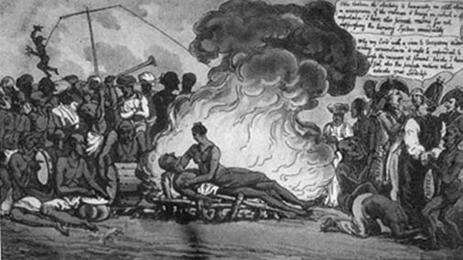
British Ban Sati
Sati: Custom of widow burning herself on the funeral pyre of her husband
British viewed custom as representative of 2 things:
  Indian backwardness
  the moral weakness of Indian men; supposedly
    degraded their women instead of protecting them
Served as a key point in the public liberal reform campaign
Civilizing mission ended, however, in 1857
  Indian Rebellion (Sepoy Rebellion)
  Officials say interference in Indian religion as causes of revolts
  Reform continued by Indian social reformers

Slide 14

Failure of Liberal Vision
  New Imperialism began to dominate and distinguish itself from the liberal empire *New social attitudes emerged from Darwinism, and British poet Rudyard Kipling (White Man’s Burden)
  DARWINISM
  Theory of evolution distorted by social Darwinists explained cultural differences; Europeans accentuated gap between them and other more ‘primitive’ cultures
  Natural selection: biology determined culture
  Race differentiation meant permanence of racial traits (sexual selection)
ENLIGHTENMENT
Single human trajectory, cultures developed at different paces
Social and natural environment shaped cultures
human mastery of nature and possibility of socially engineered progress
Mutability of human beings
Social Darwinism had a broad impact on empire and race
led to racism, and race distinctions, Eugenics—undermined liberal Enlightenment thought (more info here)

Slide 15

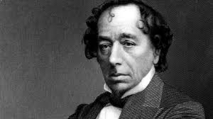
New Imperialism Politics
  Conservative Theory: (ex. Disraeli) “Imperialism is necessary to preserve the existing social order in the more developed countries. It is necessary to secure trade, markets, to maintain employment and capital exports, and to channel the energies and social conflicts of the metropolitan populations into foreign countries. There is a very strong ideological and racial assumption of Western superiority within this body of thought” (“Theories of Imperialism”)
Imperialism supported by both sides and revived the right
  Britain: Conservative party led by Prime Minister Benjamin Disraeli embraced empire
  France: Liberals and centrists promoted expansion to bolster national prestige
  Italy: liberals (Francesco Crispi, Giovanni Giolitti) pursued imperial ventures to foster Italian nationalism
Disraeli

Slide 16

Critics of Empire
  Liberal Theory: (ex. Hobson)
  “Imperialism is a policy choice, not an inevitable consequence of capitalism…Overseas expansion is a way to reduce costs (increase or maintain profit levels) and to secure new consumption. Overseas expansion is not inevitable, however. A state can solve the problem of under consumption by increasing the income levels of the majority of the population either through legislation concerning wage or through income transfers” (Theories of Imperialism”)
Belgium: parliament opposed king’s sponsorship of empire
  Right wing in Belgium and France felt is was a dangerous distraction from domestic issues
Britain: liberals opposed more expansion after Indian Rebellion
  Liberal leader: William Gladstone
Socialists: most consistent opposition
  Radicals, socialists, labor leaders likened their suppression to that of colonial subjects
Radical left opposed because saw capitalism as close tie to imperialism
J.A. Hobson: unequal distribution of wealth, only specialinterest groups benefited from colonial possessions
V.I. Lenin: imperialism linked to monopoly capitalism
Others condemned imperialism on moral grounds.They rebelled against the crude Social Darwinism of the imperialists.
They accused the imperialists of applying a double standard: liberty and equality at home, military dictatorship and discrimination in the colonies
Marxist Theory (ex. Lenin): “Imperialism also arises because increased concentration of wealth leads to underconsumption. However, since the state represents the capitalist interest it is not possible to reduce underconsumption effectively through liberal strategies. Both strategies involve taking away money from the bourgeoisie and Marx and Lenin did not view this strategy as possible. Ultimately, according to Lenin, the world would be completely divided up and the rich countries would then fight over the redivision of the world” (“Theories of Imperialism”)

Slide 17

Other Attitudes to Imperialism
Aristocrats: wanted to feel distant from and superior to subjects
  Britain: younger sons of aristocracy chose military or government service in colonies
  France: 1875, after turning anti-clerical, catholic and monarchist nobles were excluded at home but not in colonies
  Working classes: divided!
    Britain and Germany: mostly supported empire (Jingoism: mass appeal of imperialism, which was encouraged by national politicians and print media)
    France and Italy: mostly opposed; disastrous imperial ventures swept Jules Ferry and Crispi from office
        Imperialism also threatened traditional society
        Traditionalists wanted to push Western culture out and conserve the old culture and society
        Modernizers felt it was necessary to adopt Western practices
        Anti-imperialist leaders found inspiration in Western liberalism and nationalism (“Chapter 26”)

Slide 18

More Links
Interactive map of Britain’s empire
Comprehensive timeline of abolition of slavery
Disraeli and Gladstone
Evolution of liberalism in India
George Orwell, Rudyard Kipling and Empire
Condensed Study Guide on Imperialism and terms
Good study guide on The New Imperialism

